Slide 1
WEB SCRAPING
PYTHON PROJECT

Slide 2
This Project Collects the Some Useful Data From Flipkart E-Commerce Website Link by
Using of the Written Python Programming Code in PyCharm by Me. That Flipkart E-Commerce Website
is Scrapping to Collect the Data of realme Mobile Phone Product Related Name, Model, Specifications,
and Contact Details...etc. details. This Web Scrapping is doing from the Flipkart E-Commerce Website
Product Link.

Slide 3
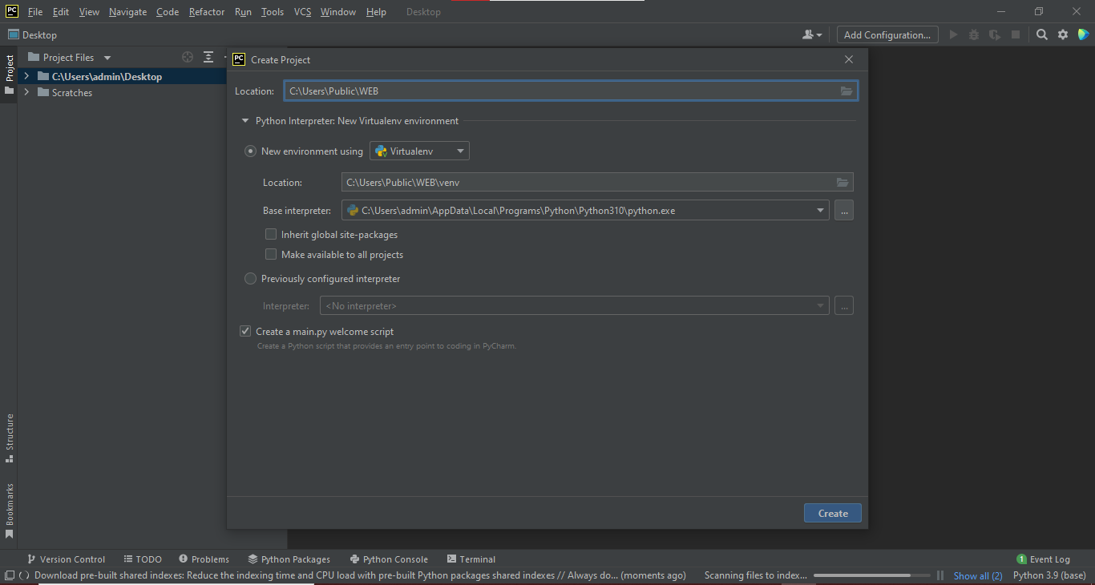
USING PYCHAM
TO CREATE VIRTUALENV

Slide 4
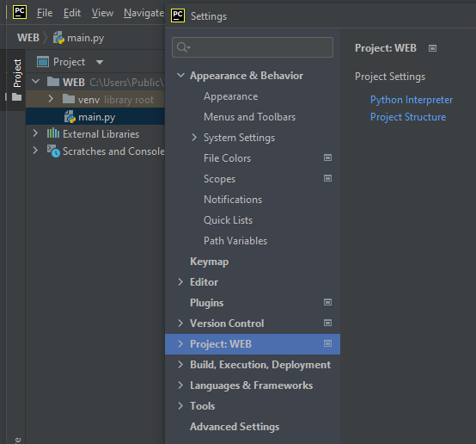
Adding FLASK,BS4,Requests
File→setting→project

Slide 5
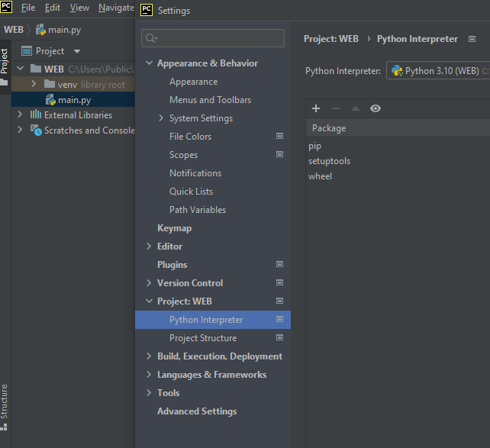
WE CAN AND MORE ADD
WHAT EVER IF WE NEEDS

Slide 6
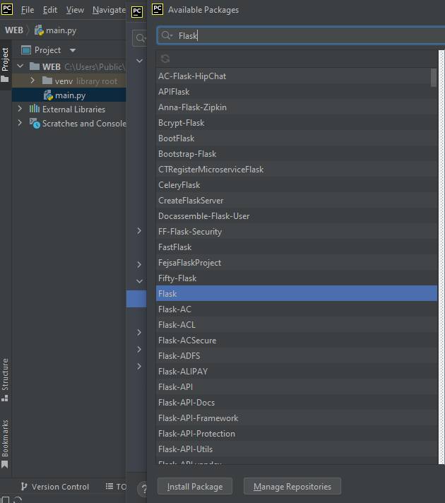
As The Way We Can Add
FLASK
To Add For Our Project

Slide 7
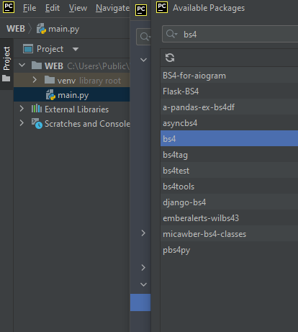
As The Way We Can Add
Bs4
To Add For Our Project

Slide 8
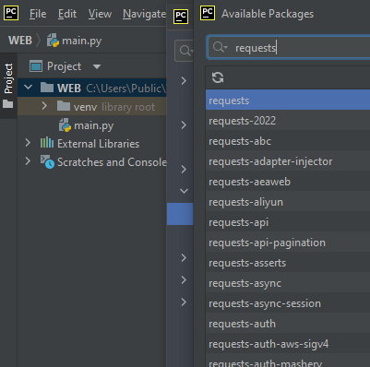
As The Way We Can Add
Requests
To Add For Our Project

Slide 9
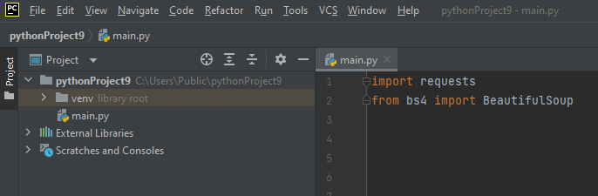
Import Module And From Bs4 Import Beautifulsoup

Slide 10
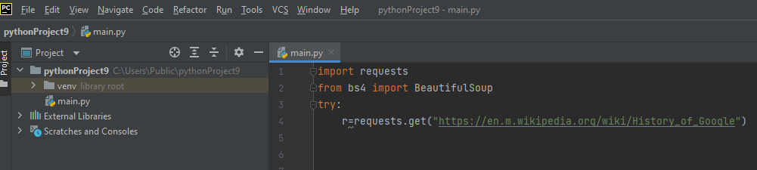
Adding Try & except Block to Find Error

Slide 11
r Is Vairable And Reqests.Get(url) What Where We Need To Get Content In Website We Must Copy And Paste Link (……..)

Slide 12
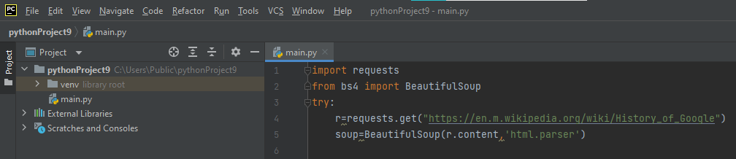
Soup Is Vairable using beautifulsoup to scarping needed content as ‘html.parser’

Slide 13
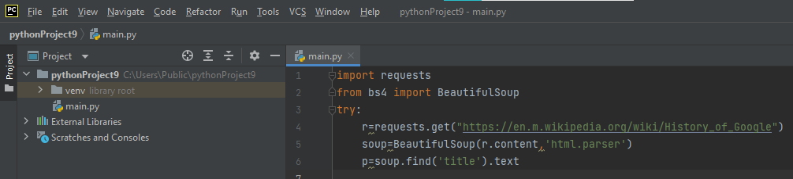
P Is Vairable Soup Is Variable As Use “.” Dot We Can Use What Ever If We Need

Slide 14
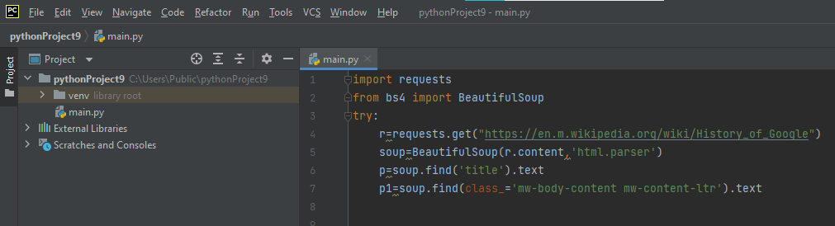
P1 Is Vairable Soup Is Variable As Use “.”Find ( class in html page ) as Content

Slide 15
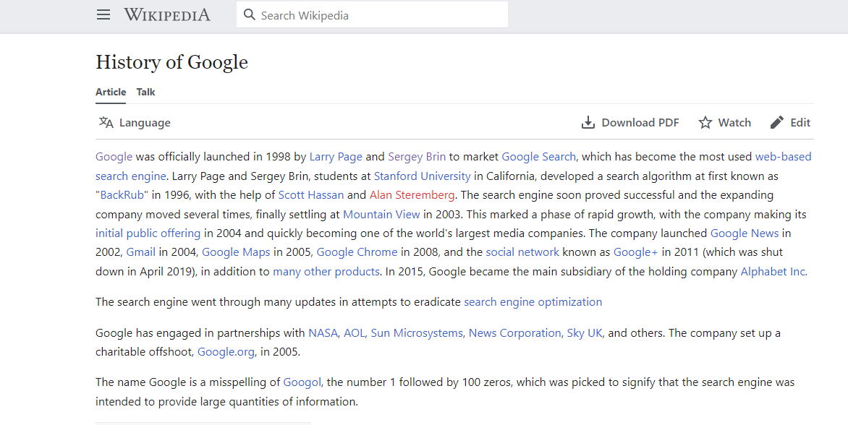
Example:
This is the web to get content to scarping using python as to get passage
This A Website To Get Content

Slide 16
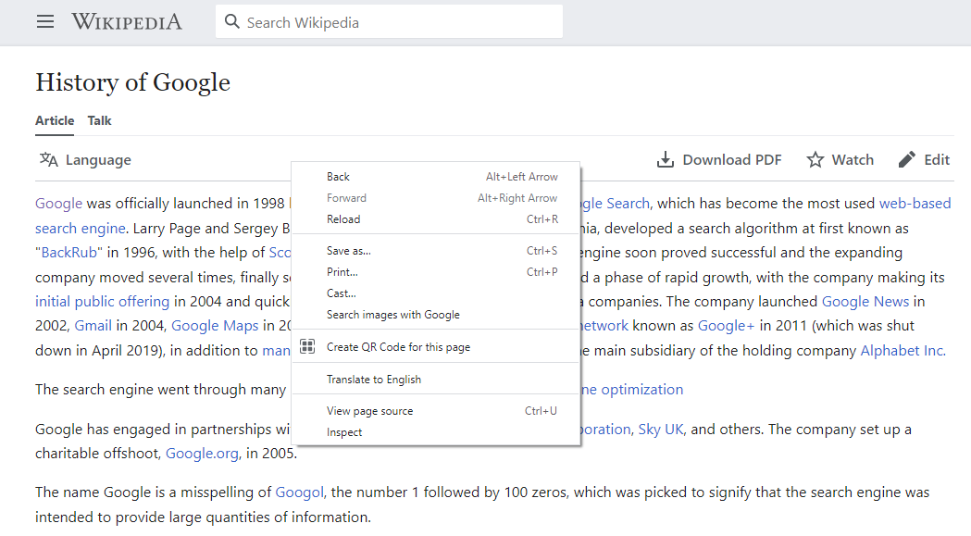
View The Html Source Right Click And → View Page Source

Slide 17
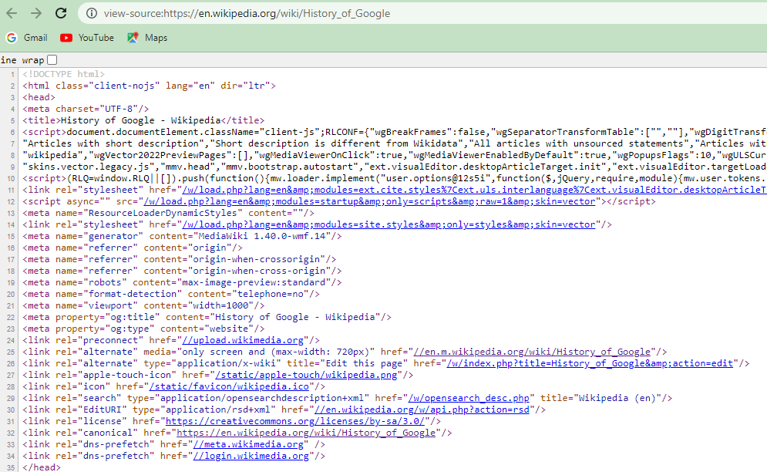
Viewing Page Source Can Able See Html File Of The Web Page

Slide 18
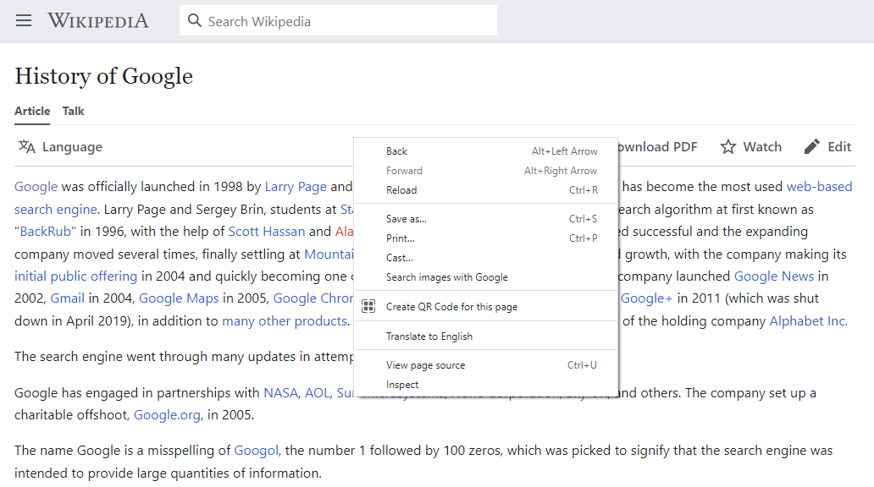
Using Of Inspect

Slide 19
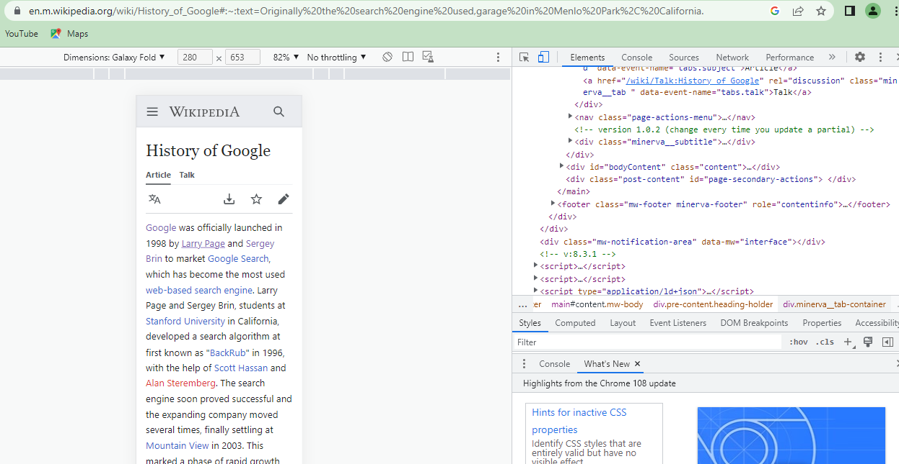
Using Of Inspect On Web Page Is Used To Know What Is Elements Of Html And Its Where Its Used
Html Tag

Slide 20
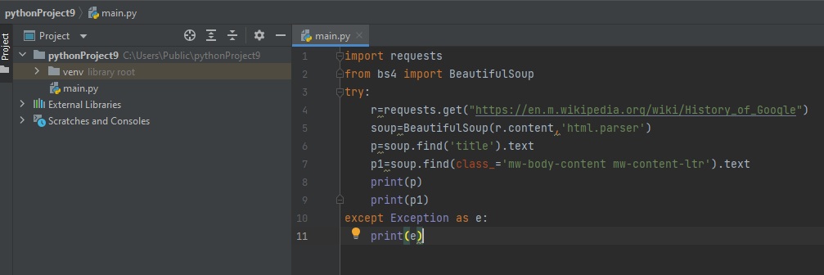
Printing The Variable P And P1 Except As Exception To Find Out Errors While Running Program

Slide 21
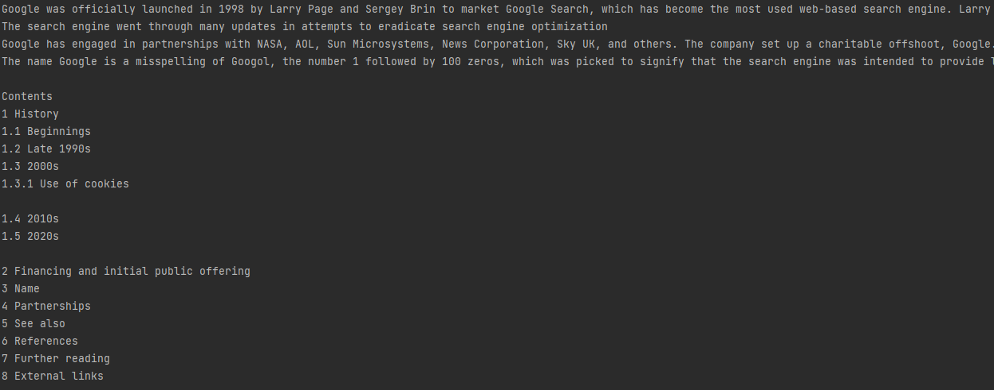
OUTPUT:

Slide 22
THANK YOU

